Slide 1
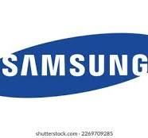
Marketing Policy of Samsung
Farjana Akter Sonia
Department of Mathematics
Batch-20
Date:5th October 2024

Slide 2
Overview
Samsung Electronics constantly reinvents the future. We explore the unknown to discover technologies to help people all over the world lead happier, healthier lives.
Samsung Group is a South Korean multinational conglomerate headquartered in Samsung Town, Seoul. It comprises numerous affiliated businesses, most of them united under the Samsung brand, and is the largest South Korean chaebol (business conglomerate). Samsung is a large worldwide company based in Seoul.
It create a culture of infinite possibilities. The deep trust and loyalty of our customers drives us to continually grow and lead innovation.

Slide 3
4P’s in Marketing
Product
Promotion
Price
Place

Slide 4
Samsung's Market Strategy
Diversified Products portfolio
Vertical integration
Global Market presence

Slide 5

Samsung Product Review

Slide 6
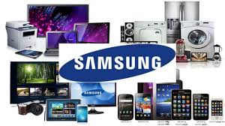
Products/Services
Samsung Electronics produces LCD and LED panels, mobile phones, memory chips, NAND flash, solid-state drives, televisions, digital cinemas screen, and laptops and many more products. The company previously produced hard-drives and printers. Samsung consistently invests in innovation.

Slide 7
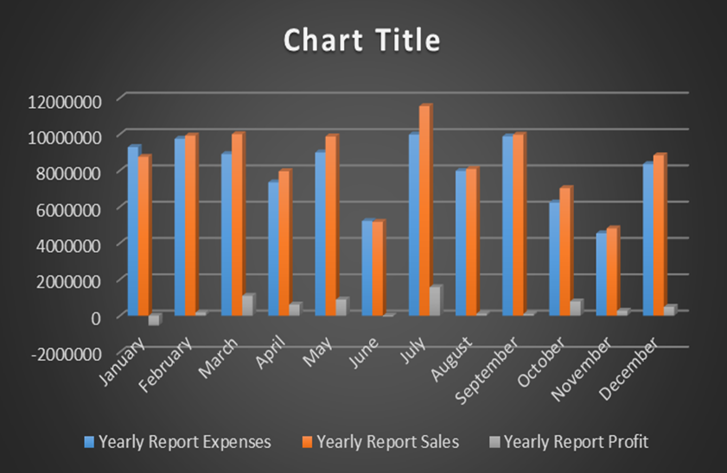
Employee Report Analysis

Slide 8
Concluding Remarks
In summary, Samsung's marketing success can be attributed to its commitment to innovation, strategic global branding, adaptability to market dynamics, customer-centric focus, effective use of digital platforms, and a robust retail strategy. These elements combined have solidified Samsung's position as a leader in the market

Slide 9
Thank you

